Slide 1
CELEBRITY FACE RECOGNITION
Presented by
Dharani
Latheefa
Roopa
Shankar
Shesa sai
Swetha

Slide 2
CONTENTS
Introduction
Technologies Used
Problem Statement
Methodology Overview
Training and Evaluation
Project Workflow Overview
Results
Benefits
Future Scope
Conclusion

Slide 3
INTRODUCTION
Introduction
Overview: This project involves the development of a sophisticated face recognition system integrated with Natural Language Processing (NLP) and a user-friendly interface. The system is capable of accurately identifying individuals from images and retrieving detailed information about them, making it highly applicable in fields such as security, social media analysis, and educational tools.
Objective: The objective of this project is to create an advanced face recognition system that not only identifies individuals but also enriches the recognition process by providing relevant information about them. This integration of technologies aims to enhance user experience and solve practical challenges in various domains.

Slide 4
Problem Statement
Challenge: Identifying celebrities from images and providing accurate, relevant information.
Objective: Build a system that:
Recognizes faces in images.
Retrieves and displays detailed information about identified celebrities from Wikipedia.
Importance: Offers a seamless way to combine visual recognition with informative content, improving user engagement and information access.

Slide 5
Technologies Uesd
TensorFlow & Keras: Frameworks for building and training the face recognition model.
Wikipedia API: Fetches information about celebrities.
Computer Vision
Natural Language Processing
NumPy: Handles numerical data operations.
Matplotlib: Visualizes training progress.
ImageDataGenerator: Augments images for better model performance.

Slide 6
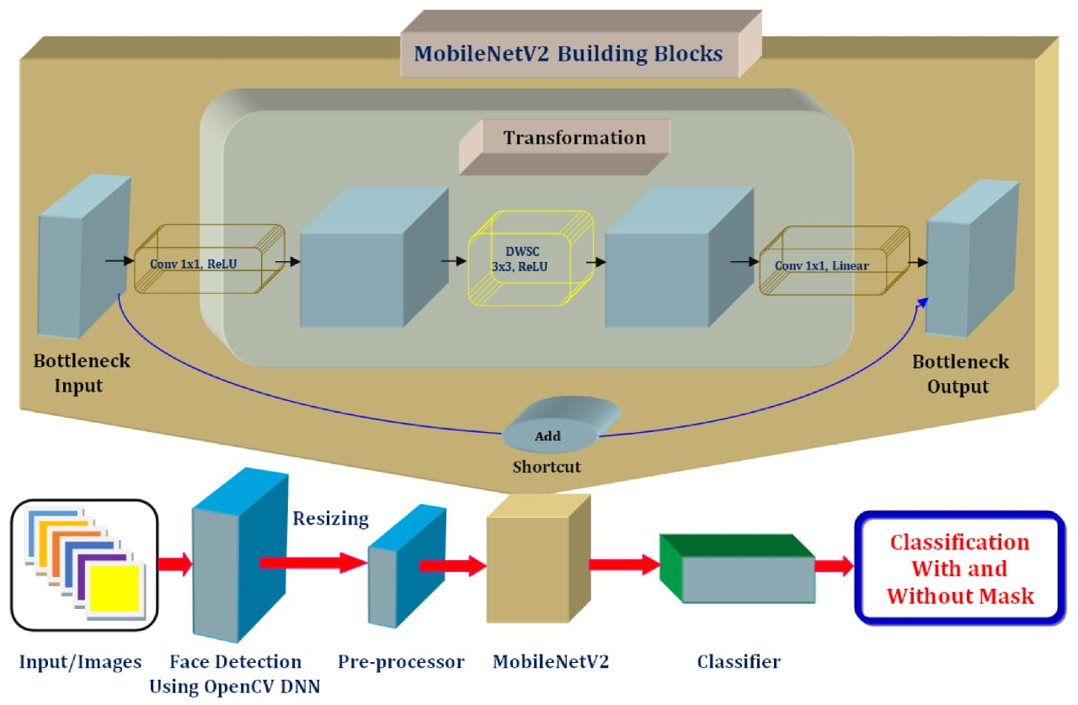

Slide 7
Methodology Overview
1.Dataset Management:
Data Extraction: Extract images from the dataset zip file and organize them into training and testing directories.
Preprocessing: Resize images to 160x160 pixels, normalize pixel values, and apply data augmentation techniques such as flipping, rotation, and scaling to create a diverse training set.
2. Model Architecture:
Feature Extraction: Use MobileNetV2 as the backbone model with pre-trained weights to extract features from images.
Custom Layers: Add a global average pooling layer, dropout for regularization, and a dense output layer with softmax activation to classify images into different celebrity categories.

Slide 8
Training and Evaluation
1.Training Process:
Data Generators: Utilize ImageDataGenerator to stream images from directories and perform real-time data augmentation.
Model Training: Fit the model on the training set with early stopping callbacks to halt training once the model achieves 98% accuracy.
Validation: Validate the model performance on the testing set to ensure generalization.
2. Model Evaluation and Use:
Performance Metrics: Assess model accuracy and loss using metrics from training and validation phases.
Prediction: Load and preprocess test images, then use the trained model to predict celebrity identities.
Information Retrieval: Integrate with external APIs (e.g., Wikipedia) to fetch detailed information about recognized celebrities.

Slide 9
Project Workflow Overview
1
2
3
4
5
Data Preparation
Extracting and organizing the image dataset for training and testing.
Model Development
Creating and training a custom deep learning model on the dataset.
Training Process
Applying the trained model to classify and recognize images.
Prediction Phase
Fetching and displaying relevant information about recognized entities.
User Interface Design
Developing an intuitive UI for user interaction and results display.

Slide 10
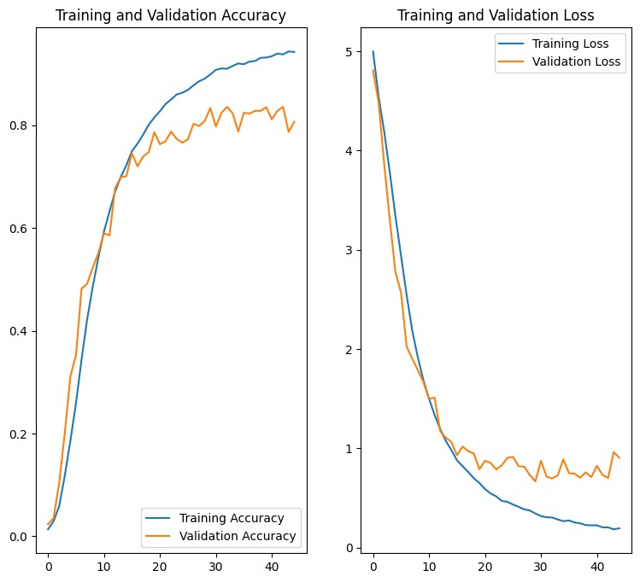
Results Overview and System Screens
Visualizing Training
Accuracy
and
Loss

Slide 11
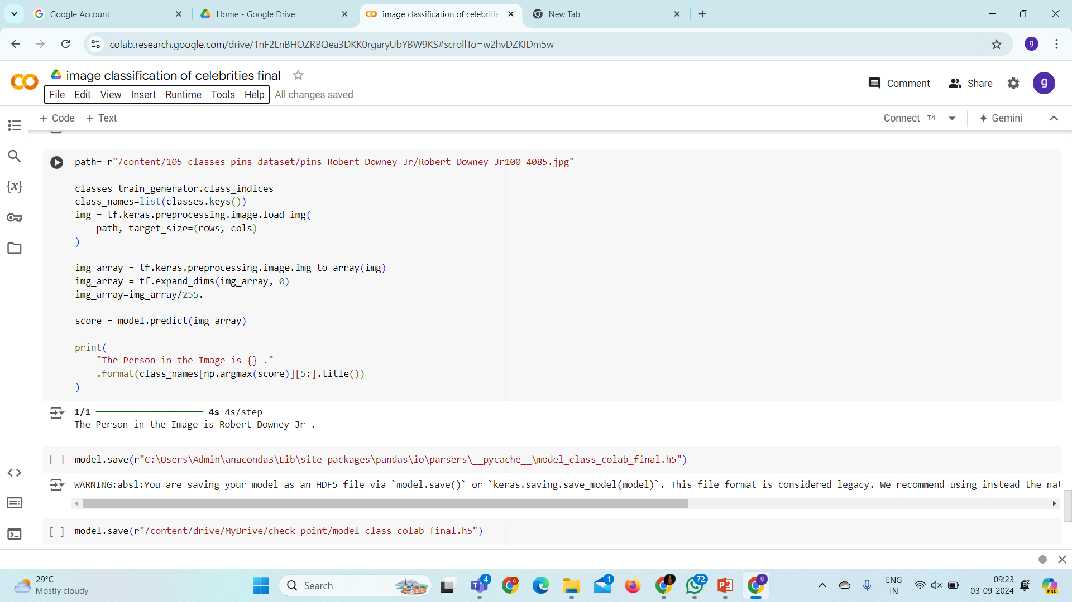

Slide 12
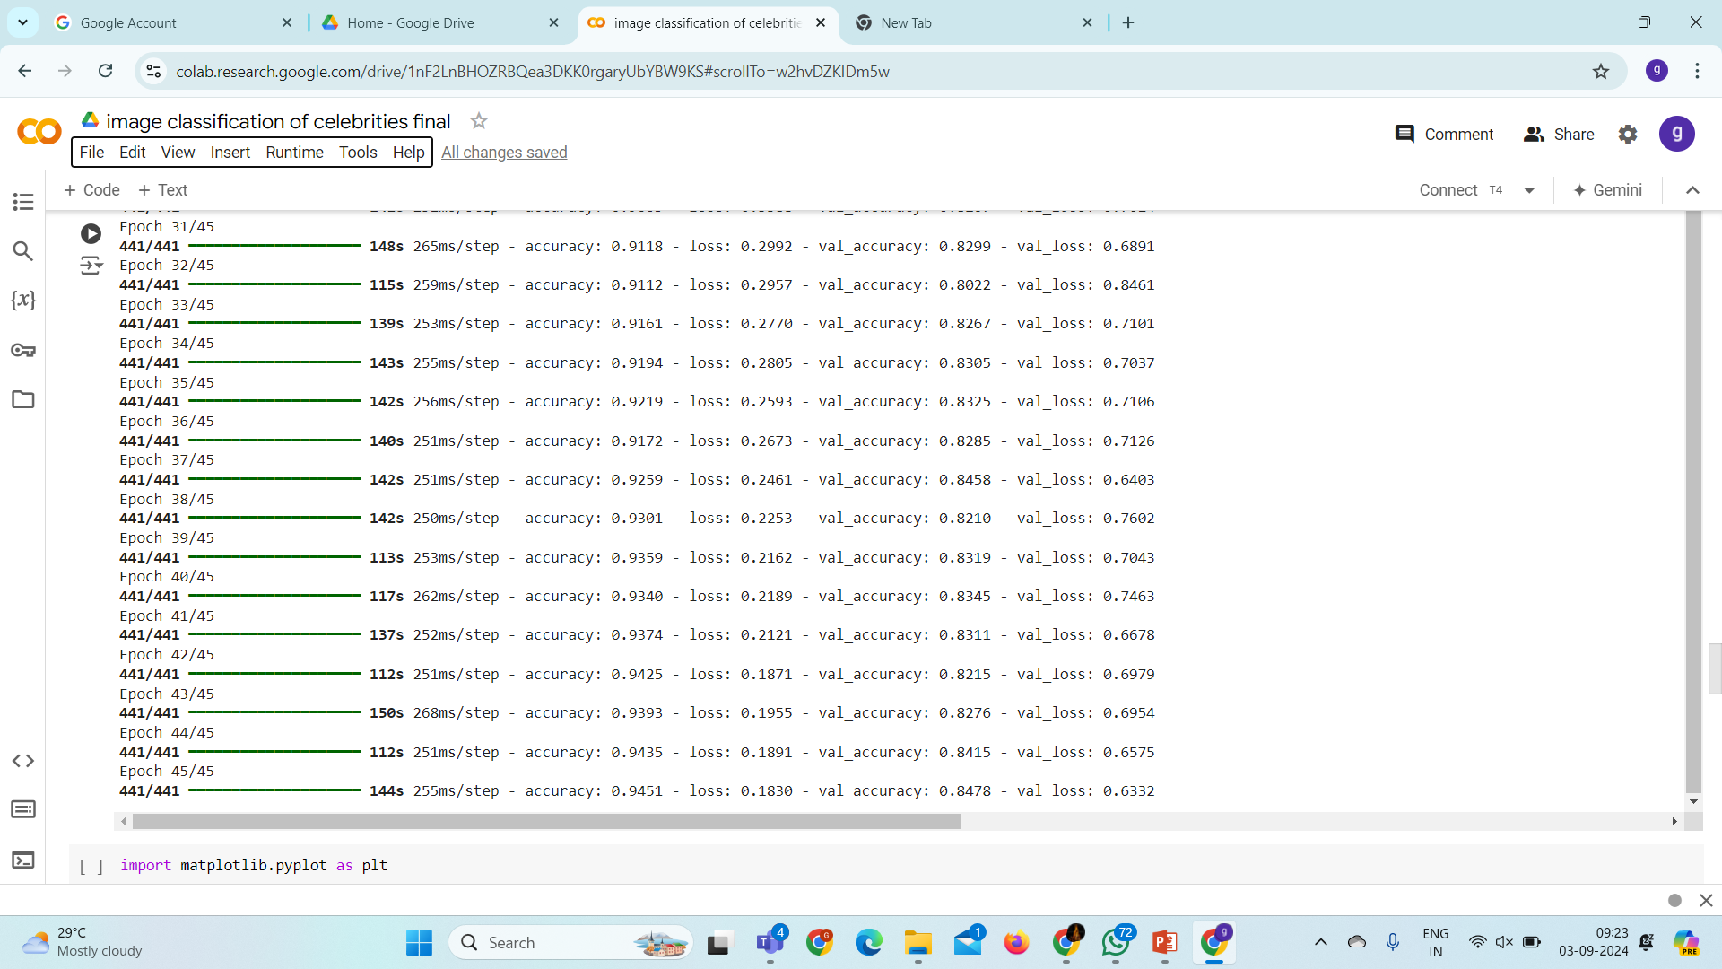

Slide 14
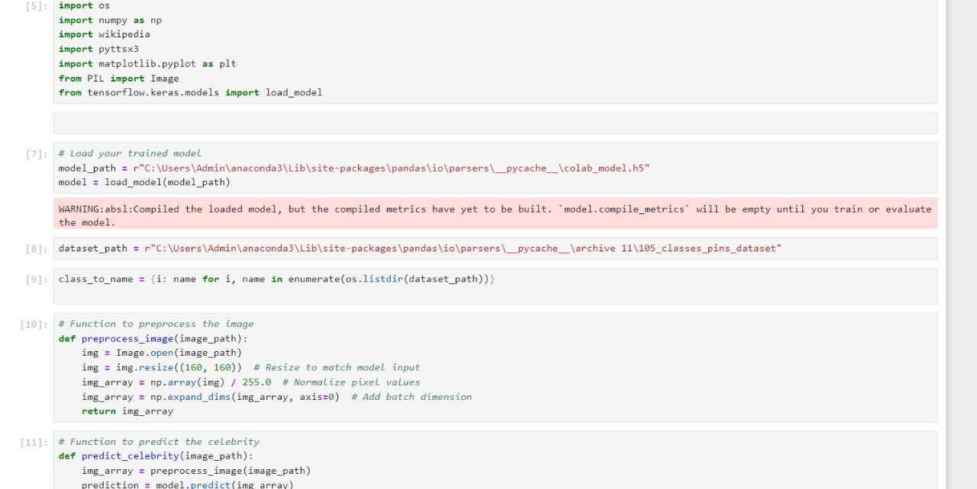
NLP Extension Code: Wikipedia Integration

Slide 15
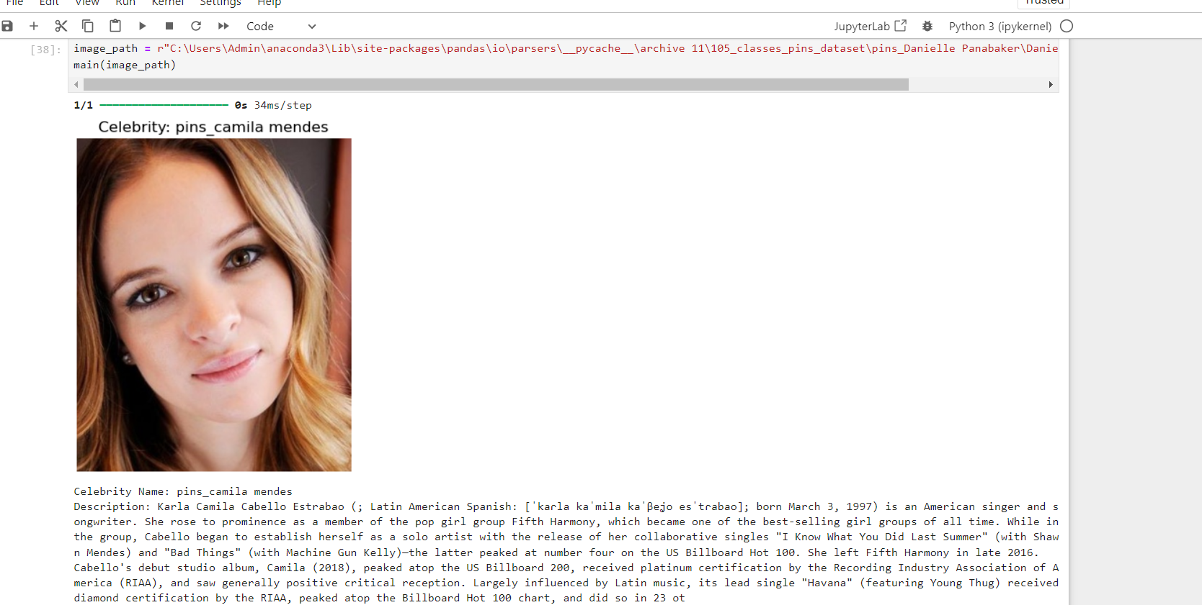

Slide 16
BENEFITS
Early Detection: Quickly identify and verify celebrity faces in images or videos to ensure accuracy and prevent misuse.
High Accuracy: Use advanced AI techniques to recognize celebrities with high precision by detecting subtle details in their appearance.
User-Friendly: Provide easy-to-use tools that let users effortlessly identify celebrities and access information about them.
Information Retrieval: Automatically gather detailed information about recognized celebrities, such as biographies or recent news, enhancing the user experience.

Slide 17
CONCLUSION
The celebrity face recognition project is a major leap forward in identifying and interacting with public figures. Using advanced AI, it accurately recognizes celebrities and provides detailed information.
Future improvements will aim for even better accuracy, real-time recognition, and global reach. The project highlights AI’s potential and sets the stage for more innovative and engaging applications. As technology progresses, the project will continue to evolve and offer enhanced solutions.

Slide 18
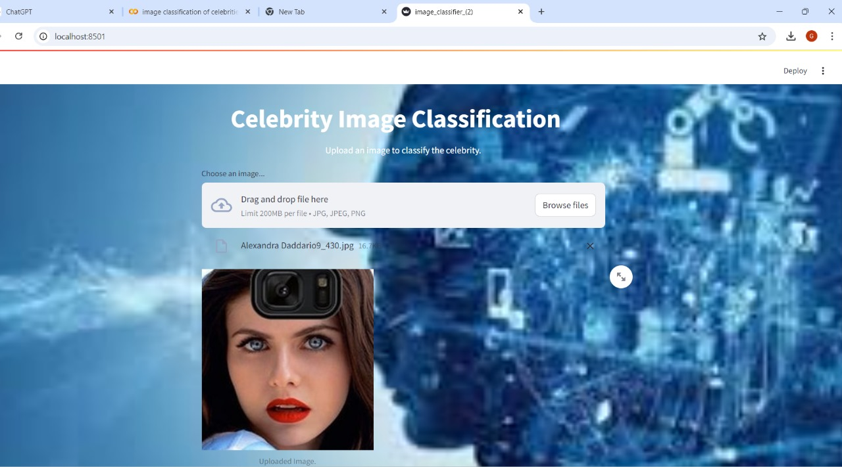
Results Overview and System Screens

Slide 19
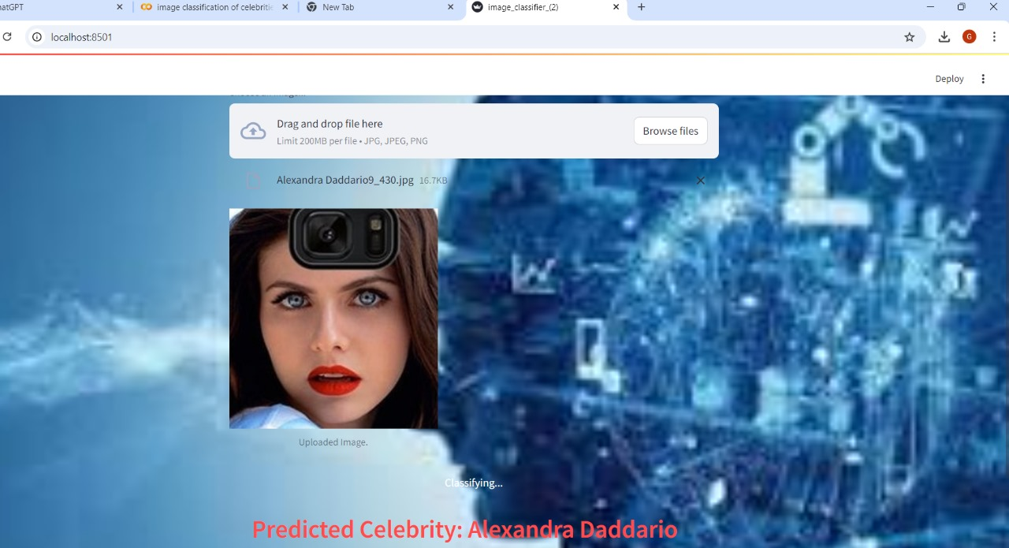
Results Overview and System Screens
Results Overview and System Screens

Slide 20
Future Scope
Real-Time Recognition: Enable live celebrity identification during events and integrate with AR for interactive experiences.
Detailed Information: Provide richer, more relevant information about celebrities, including recent news and personal achievements.
Tech Integration: Combine with other technologies like voice recognition for more interactive user experiences.

Slide 21
THANK YOU

